Slide 1
Android Application Development (I)
Practice – Project Breakdown (App Structure)

Slide 2
Agenda
Self Introduction
Intellectual Property Rights
Project Introduction
Android Introduction
Get Started with Android
Requirement
Object-Oriented Analysis and Design
Scrum
Project Breakdown
Acceptance Test Criteria
Publish Application
Notes:
Object-oriented analysis and design (OOAD) is a software engineering approach that models a system as a group of interacting objects. Each object represents some entity of interest in the system being modeled, and is characterised by its class, its state (data elements), and its behavior. Various models can be created to show the static structure, dynamic behavior, and run-time deployment of these collaborating objects. There are a number of different notations for representing these models, such as the Unified Modeling Language (UML).
Object-oriented analysis (OOA) applies object-modeling techniques to analyze the functional requirements for a system. Object-oriented design (OOD) elaborates the analysis models to produce implementation specifications. OOA focuses on what the system does, OOD on how the system does it.
Ref: http://en.wikipedia.org/wiki/Object-oriented_analysis_and_design
IFRS - International Financial Reporting Standards
GAAP - Generally Accepted Accounting Principles

Slide 3
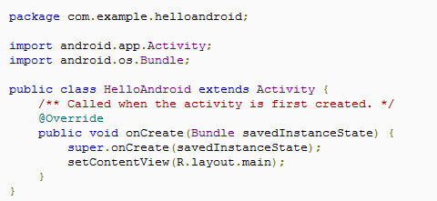
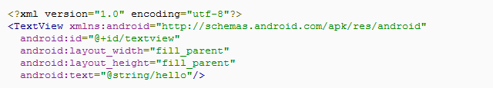
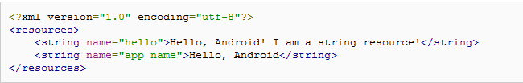
Hello World
Install a Platform
Create an AVD
Create a New Android Project
Construct the UI with XML Layout
Run the Application
[REF]

Slide 4
Hello World
Ctrl + Shift + O to import the required packages
Install a Platform
Create an AVD
Create a New Android Project
Construct the UI with XML Layout
Run the Application
[REF]

Slide 5
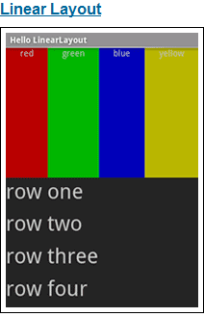
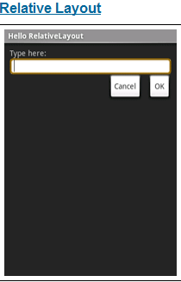

Hello View Linear Layout & Relative Layout
[REF]

Slide 6
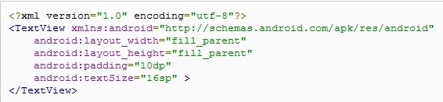
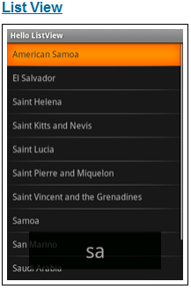
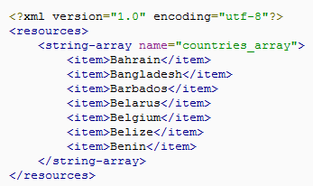
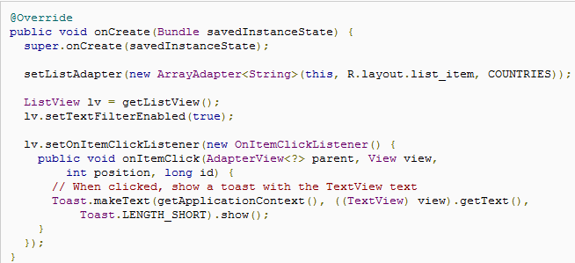
Hello View List View
1
2
3
[REF]

Slide 7
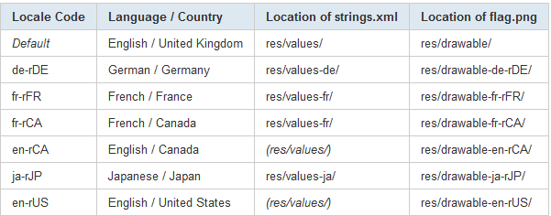
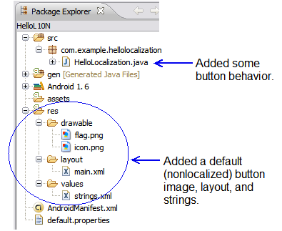
Hello Localization
[REF]

Slide 8
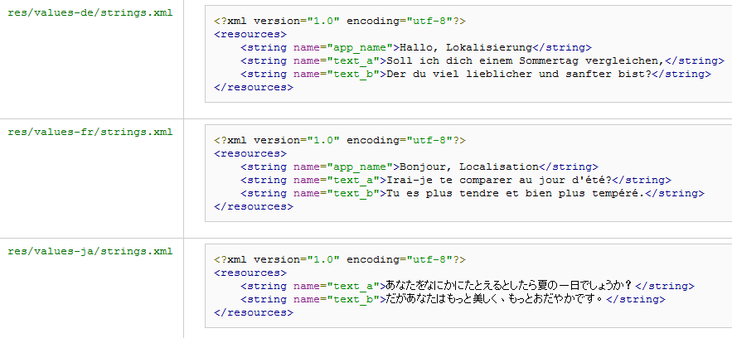
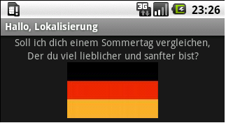
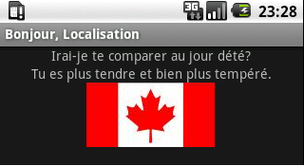
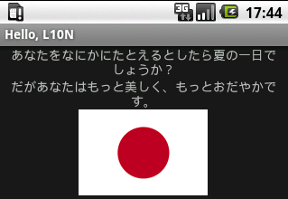
Hello Localization Cont.
[REF]

Slide 9
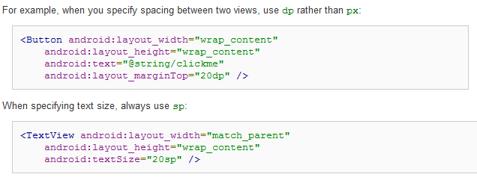
Support Different Densities Use Density –independent Pixels
Defining layout dimensions with pixels is a problem because different screens have different pixel densities, so the same number of pixels may correspond to different physical sizes on different devices. [Ref]
A dp is a density-independent pixel that corresponds to the physical size of a pixel at 160 dpi (Dots per inch).
An sp is the same base unit, but is scaled by the user's preferred text size (it’s a scale-independent pixel), so you should use this measurement unit when defining text size (but never for layout sizes).
[REF]

Slide 10
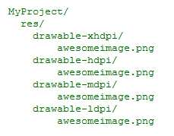
Support Different Densities Provide Alternative Bitmaps
To generate these images, you should start with your raw resource in vector format and generate the images for each density using the following size scale:
xhdpi: 2.0
hdpi: 1.5
mdpi: 1.0 (baseline)
ldpi: 0.75
 | xhdpi | hdpi | mdpi | ldpi
Scale | 2.0 | 1.5 | 1.0 | 0.75
Image | 200 * 200 | 150 * 150 | 100 * 100 | 75 * 75
[REF]

Slide 11

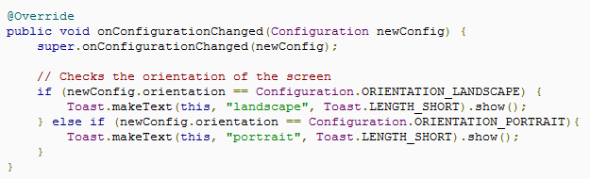
Handling Runtime Changes Landscape and Portrait
Declares an activity that handles both the screen orientation change
Implement onConfigurationChanged() to checks the current device orientation
[REF]

Slide 12

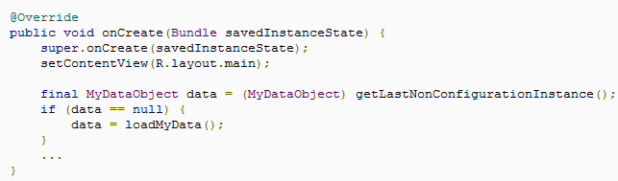
Handling Runtime Changes Retain an object during a configuration change
Incorrect Handling in Runtime Changes will cause low user experience
To recover large sets of data, re-establish a network connection, or perform other intensive operations
To completely restore your activity state with the Bundle that the system saves for you with the onSaveInstanceState() callback
It is not designed to carry large objects (such as bitmaps) and the data within it must be serialized then deserialized, which can consume a lot of memory and make the configuration change slow.
Method for change
Override the onRetainNonConfigurationInstance() method to return the object you would like to retain.
When your activity is created again,call getLastNonConfigurationInstance() to recover your object.
[REF]

Slide 13
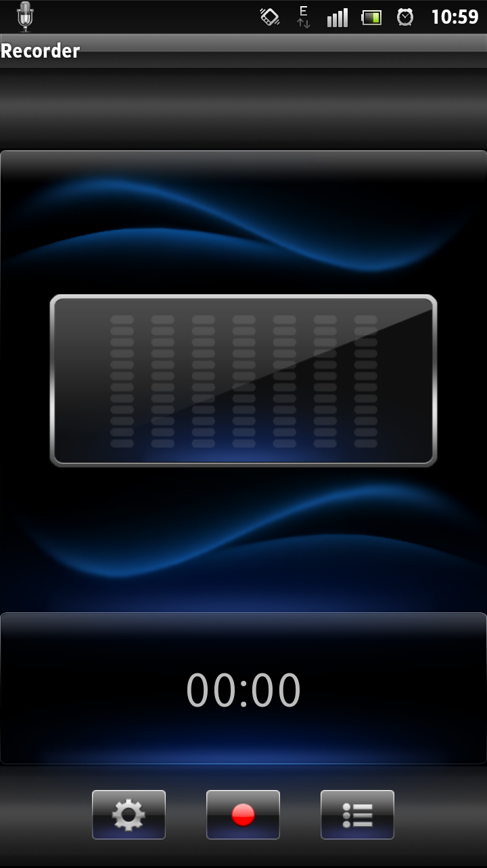
Project Breakdown (SoundRecorder) Requirement - Record Activity
recordTop
Use text view to display the name (formatted with yyyymmddx…x) of the audio while recording
recordMiddle
Basic (Mandatory): use standard view to display the default volume background
Advanced (Optional): use customized view to display the audio spectrum in accordance with the volume of voice while recording
recordBottom – Time
Basic (Mandatory): use text view to display the time while recording with the default set value for maximum recording time
Advanced (Optional): use text view to display the time while recording according to setting preference
recordBottom – Button
Basic (Mandatory): one image button for recording/stopping while another image button for launching play activity
Advanced (Optional): one button for setting preference (time limitation and format of audio file) while recording
recordTop
recordMiddle
Time
recordBottom
Button

Slide 14
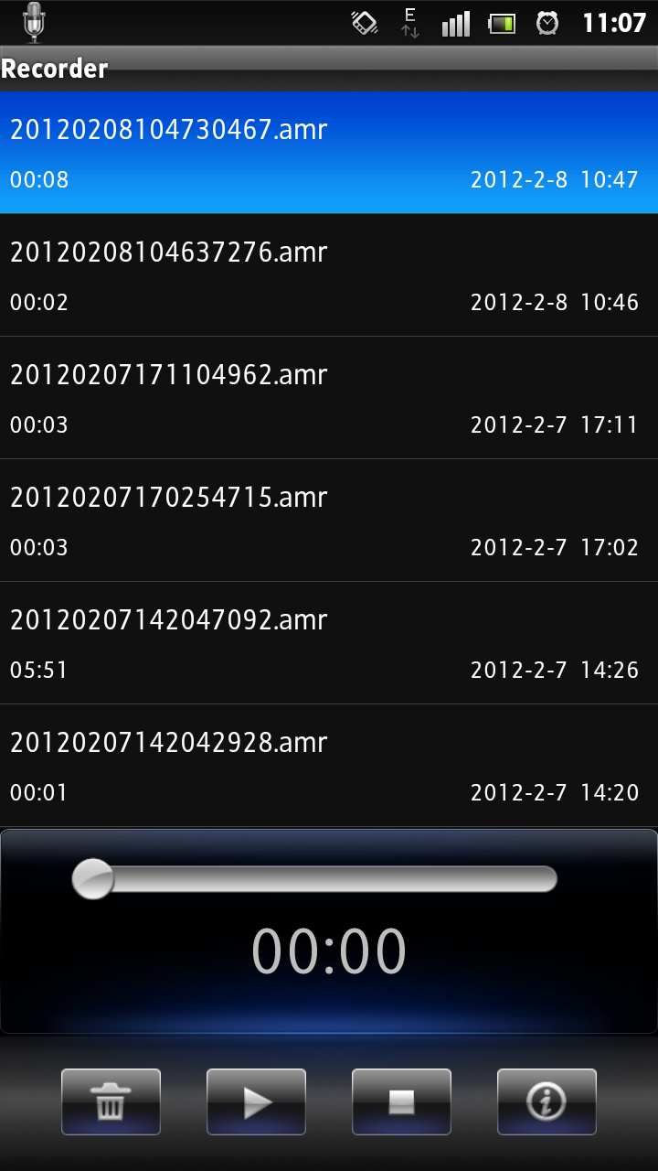
Project Breakdown (SoundRecorder) Requirement - Play Activity
playTop
Basic (Mandatory): use list view to display all items of recorded audio files with ONLY file name
Advanced (Optional): use list view to display all items of recorded audio files with file name, file duration and file date (Hint: define the layout)
recordBottom - Progress
Basic (Mandatory): use standard view to display the default progress bar background
Advanced (Optional): use customized view to display the progress bar in accordance with the progress of audio file while playing
recordBottom – Time
Basic (Mandatory): use text view to display the time of audio file while playing
Advanced (Optional): the time will be changed automatically while quickly forwarding the progress
recordBottom – Button
Basic (Mandatory): one image button for playing/pausing, one image button for stopping, and one button for deleting
Advanced (Optional): one button for displaying the detailed information of audio content
playTop
Progress
Time
playBottom
Button

Slide 15

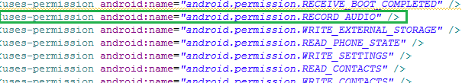
Project Breakdown (SoundRecorder) Hints – AndroidManifest
AndroidManifest.xml
Activity
uses-permission
Request Permission

Slide 16
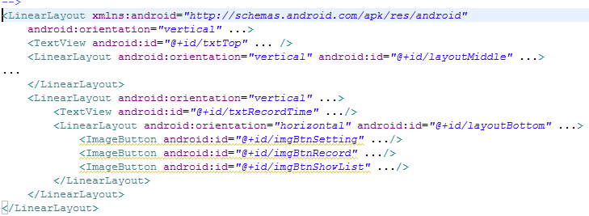
Project Breakdown (SoundRecorder) Hints – Resource Layout for Record
Record.xml
recordTop
recordMiddle
recordBottom - Time
recordBottom - Button

Slide 17
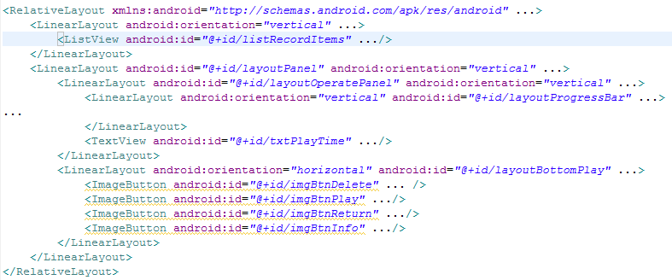
Project Breakdown (SoundRecorder) Hints – Resource Layout for Play
Play.xml
playTop
playBottom - Progress
playBottom - Time
playBottom - Button

Slide 18
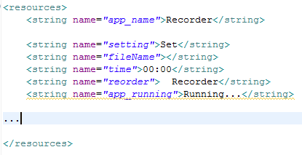
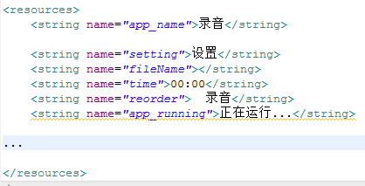
Project Breakdown (SoundRecorder) Hints – Resource Locale String
String.xml
EN
CN

